Slide 1
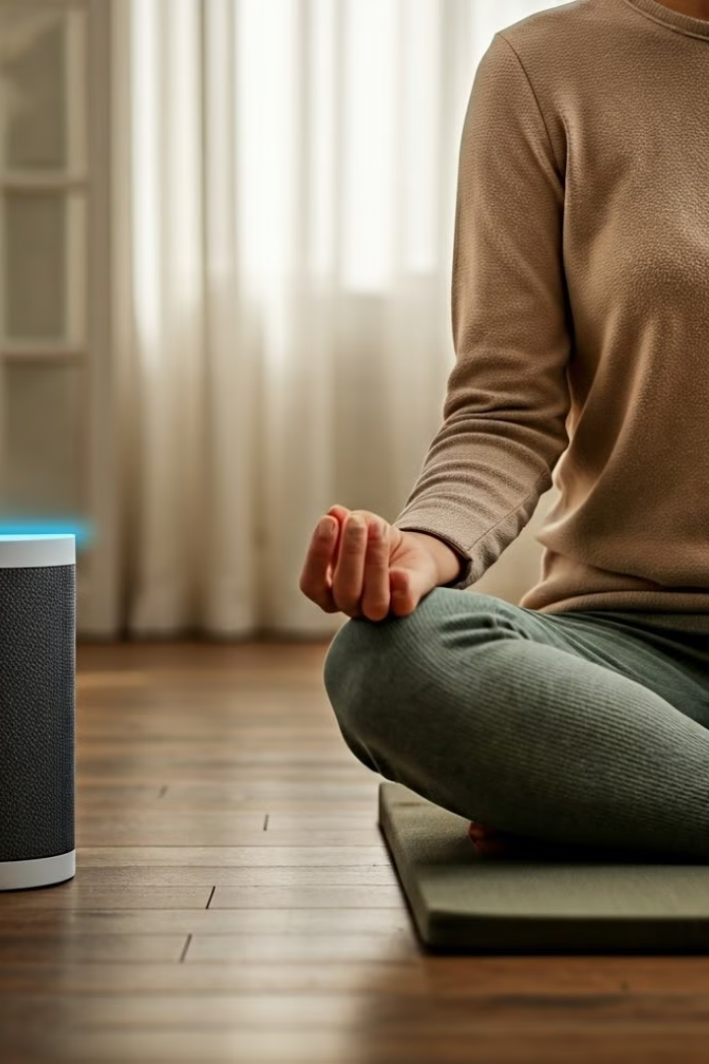
IoT and Healthcare: Personalized Mental Well-being
This system uses IoT to monitor physiological and environmental factors. It provides personalized mental wellness recommendations.
NULL Pointers

Slide 2

Mental Wellness Monitoring Application
This document details the design and implementation of an Arduino programming implemented Kivy-based application for monitoring and visualizing mental wellness metrics. The application leverages real-time data acquisition, sophisticated data visualization techniques, and personalized wellness recommendations to provide users with a comprehensive mental health monitoring tool. It integrates with external APIs for data retrieval and incorporates emergency contact features for enhanced user safety.

Slide 3
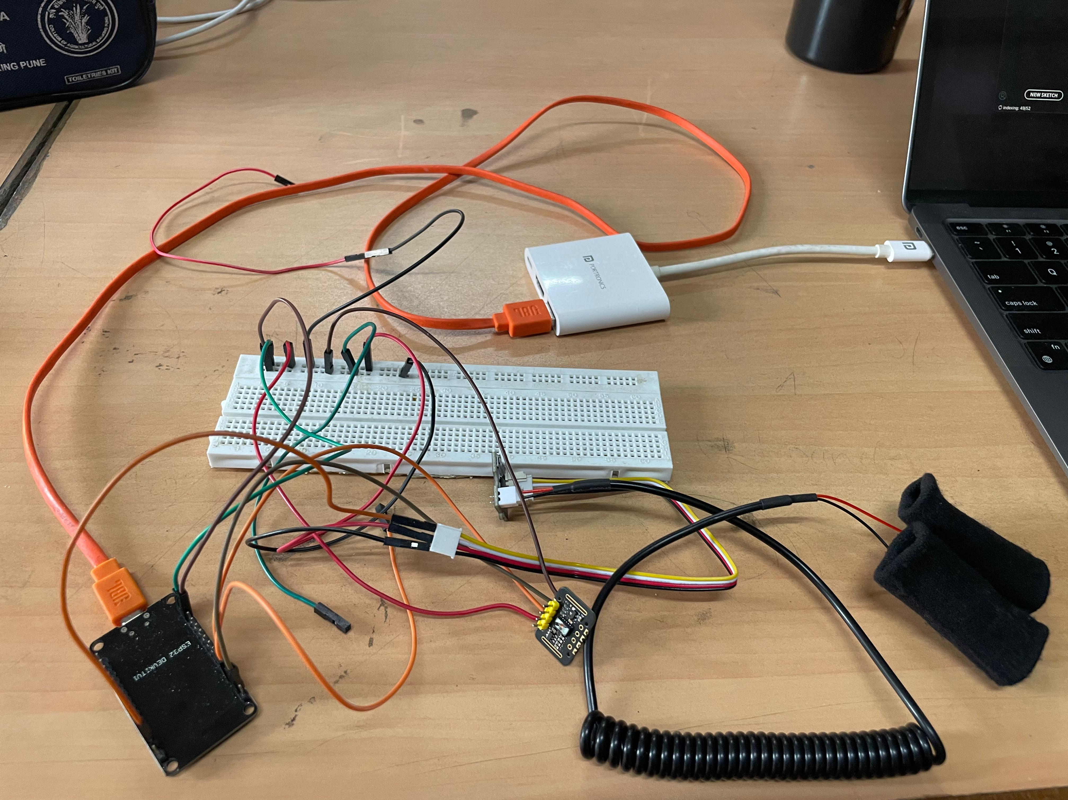




Hardware Components
ESP32
Acts as the central processing unit.
MAX30102
Monitors heart rate and SpO2.
GSR Sensor
Measures skin conductivity for stress.
DS18B20
Records ambient temperature data.

Slide 4
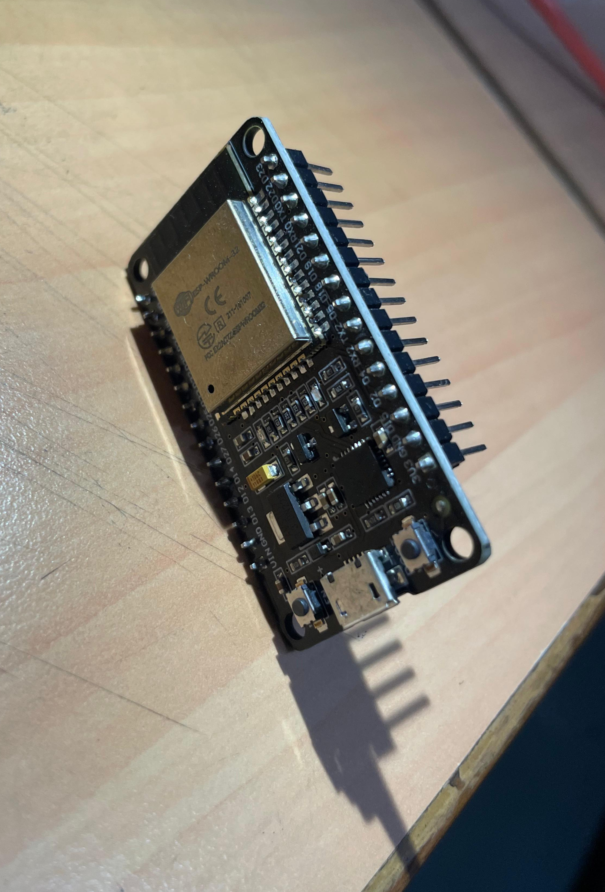
ESP32 Functionality
1
Power Supply
Provides 3.3V to all connected sensors.
2
Data Collection
Gathers data from sensors via GPIO pins.
3
Cloud Connectivity
Transmits data to the cloud (ThingSpeak) using Wi-Fi.

Slide 5
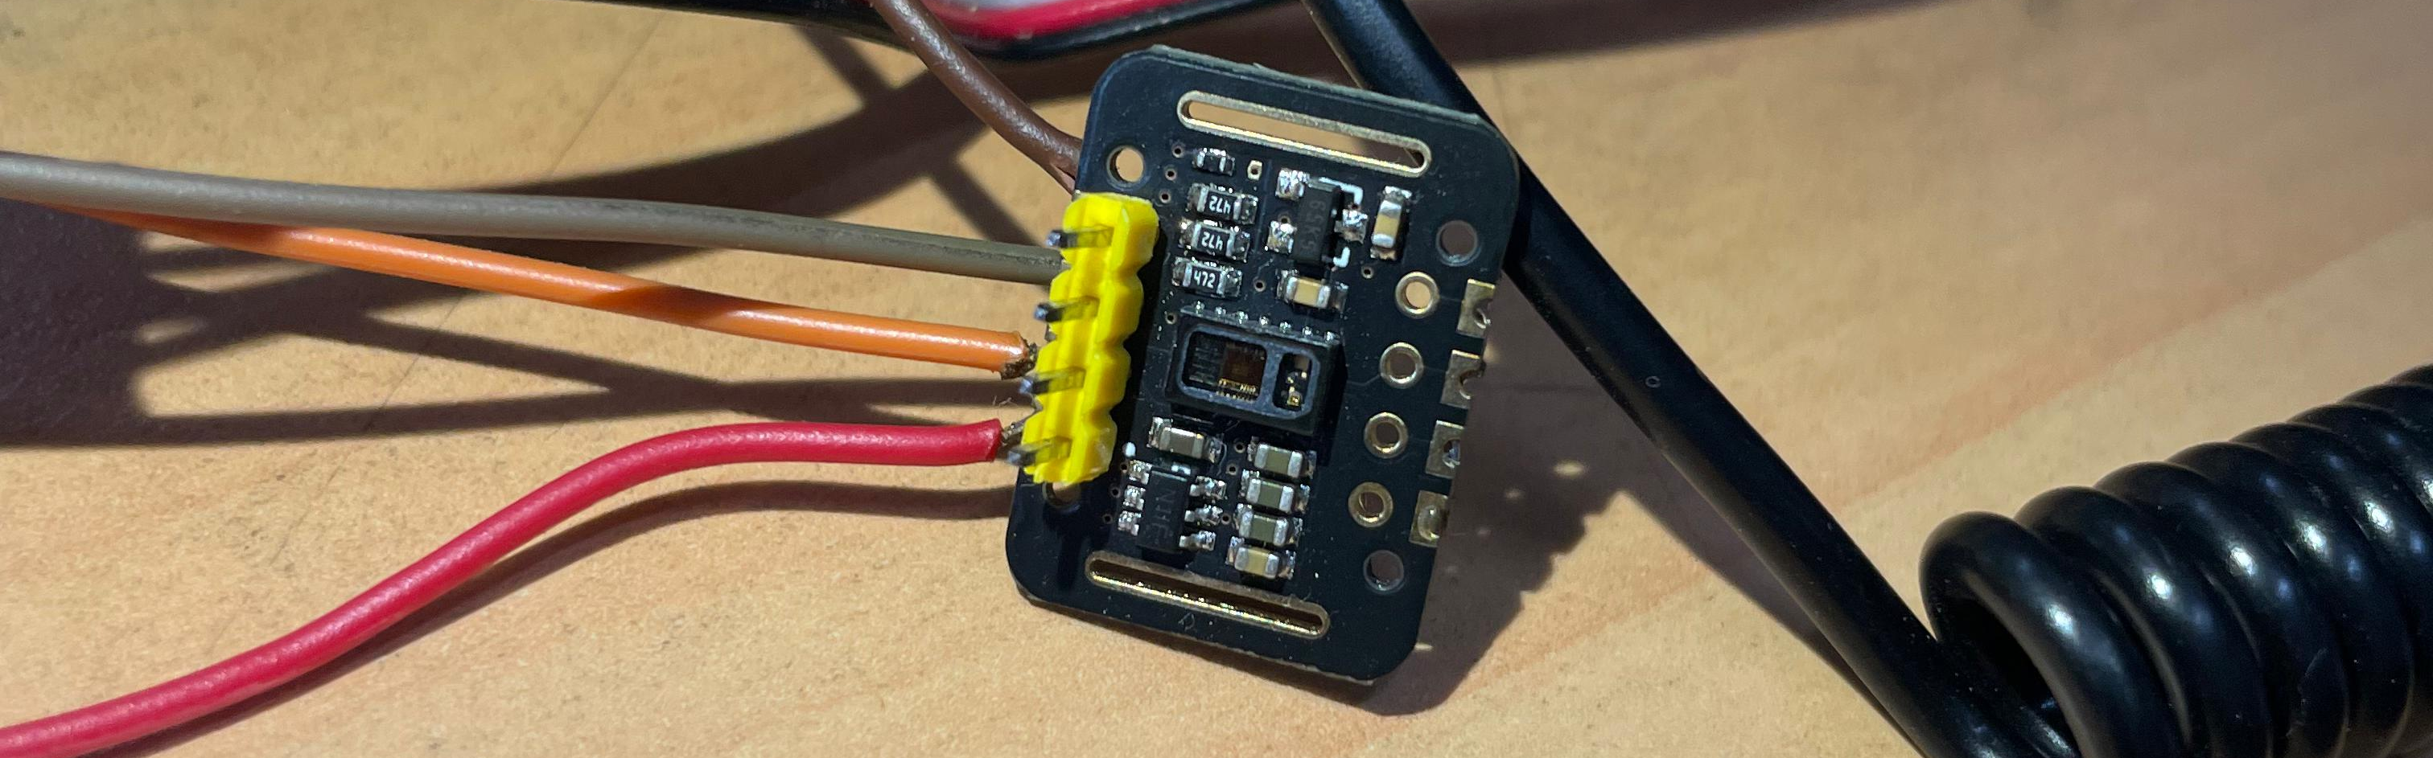
MAX30102: Heart Rate and SpO2
I2C Communication
Power
Ground
Uses SDA (GPIO 21) and SCL (GPIO 22).
Connected to the ESP32's 3.3V pin.
Connected to the ESP32's GND pin.

Slide 6



GSR Sensor: Skin Conductivity
Analog Signal
Sensor outputs an analog signal.
ESP32 Connection
Signal read by ESP32's GPIO 36 (A0).
Stress Detection
Changes in skin conductivity indicate stress.

Slide 7
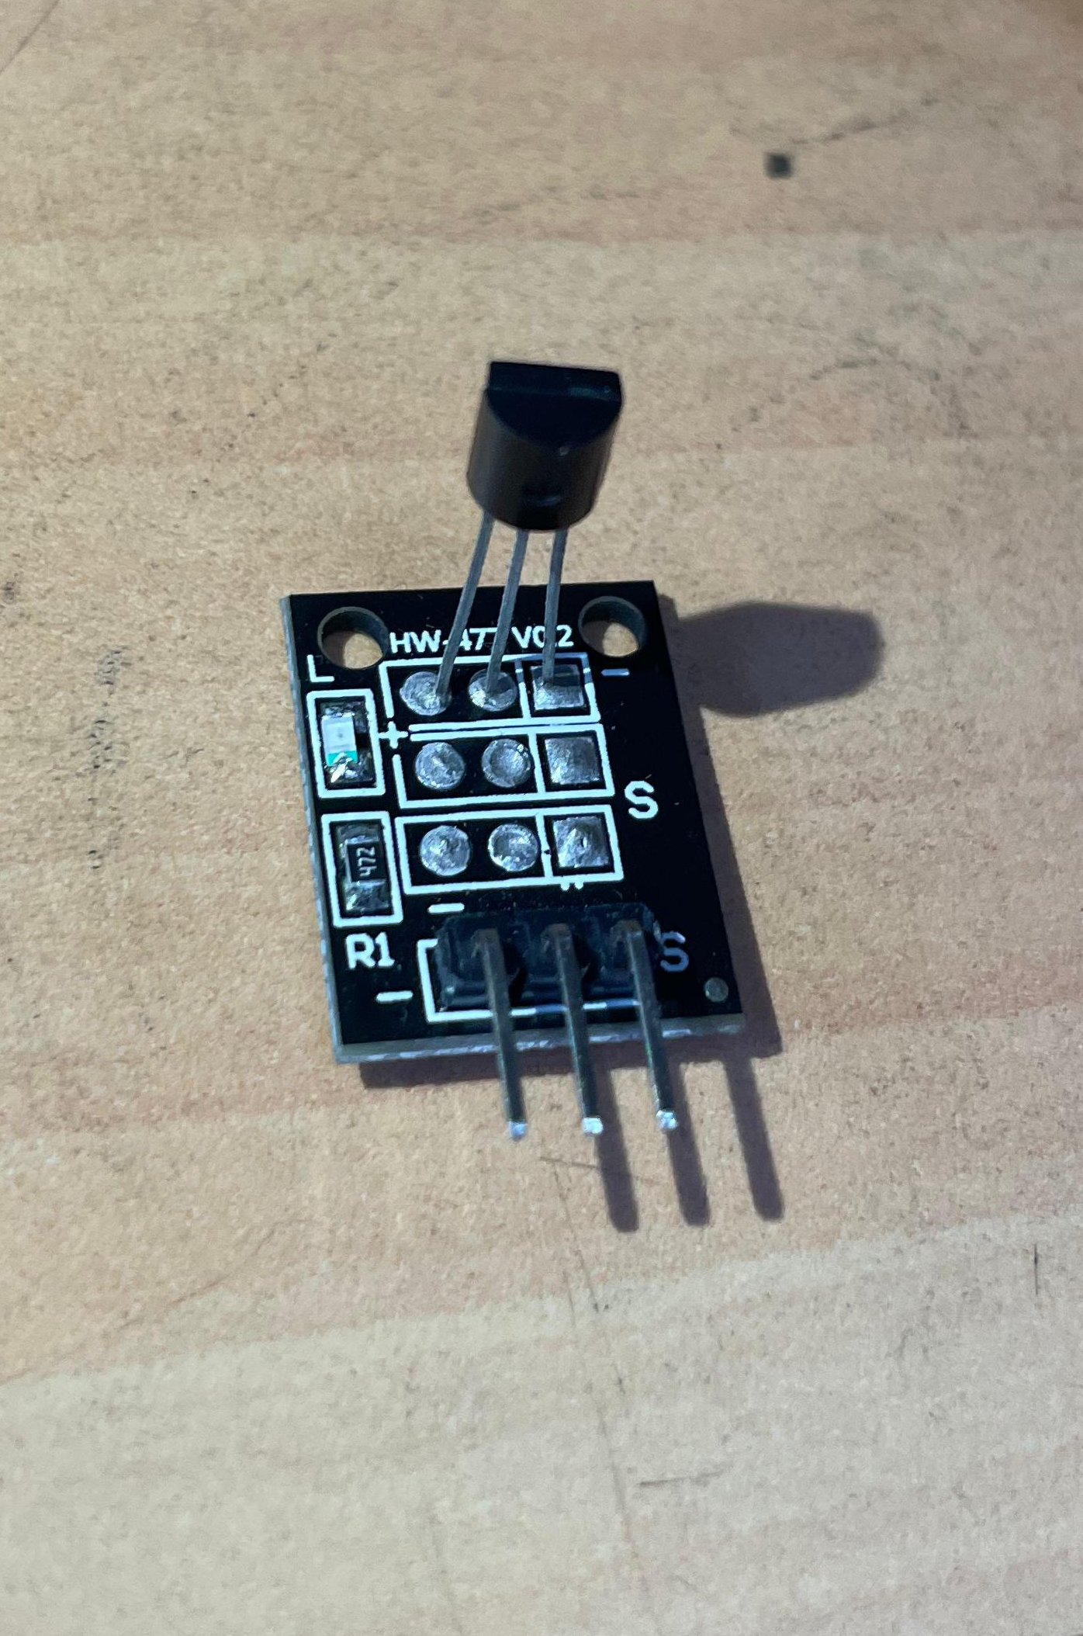
DS18B20: Temperature Sensing
OneWire Protocol
Uses single data wire (GPIO 4).
Power and Ground
Connected to ESP32's 3.3V and GND.
Multiple Sensors
Can support multiple sensors on one wire.
Ambient Temperature
Measures surrounding temperature data.

Slide 8
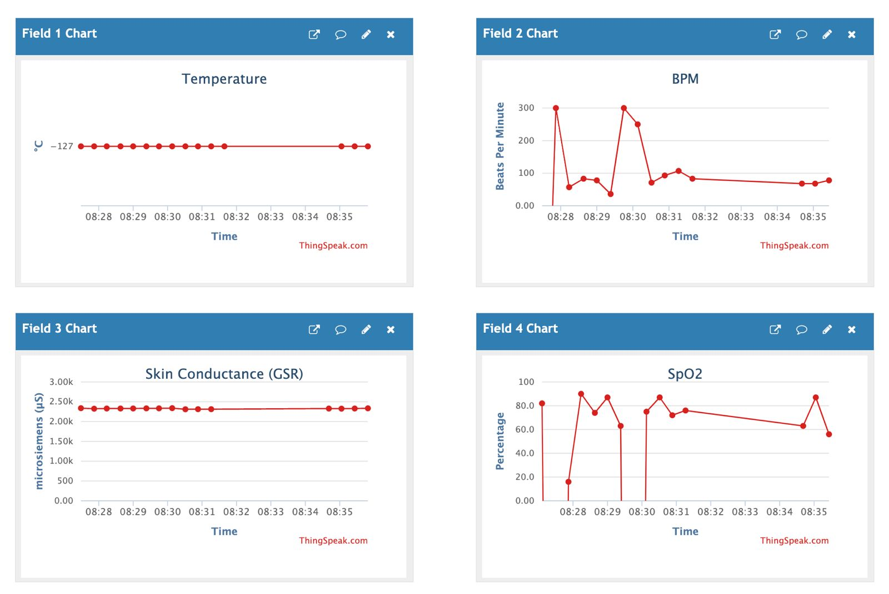
Data Acquisition and Processing
The application fetches real-time data from a ThingSpeak API, updating every 15 seconds. This data includes physiological metrics like heart rate, SpO2, body temperature, and skin conductance (GSR). GSR and heart rate are then processed to estimate the user's stress level, providing a dynamic assessment of their mental state.
1
2
3
Data Fetch
Stress Calculation
Visualization
Retrieve data from ThingSpeak API (HR, SpO2, Temp, GSR).
Process GSR and HR to estimate stress levels.
Display metrics and stress level on the UI.

Slide 9
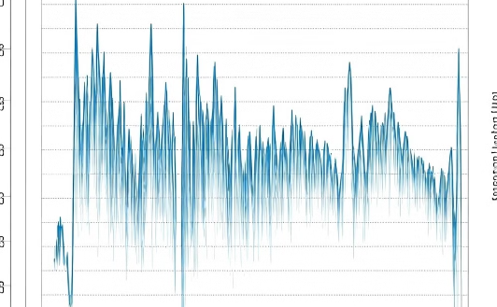
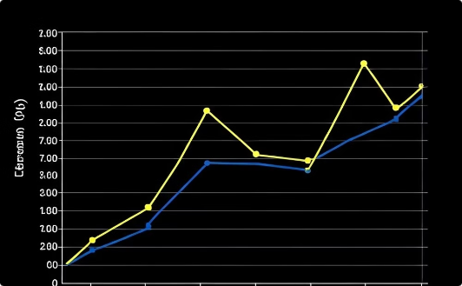
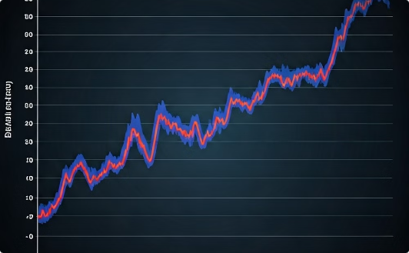
Metric Visualization
Each metric is visualized using interactive graphs powered by the kivy_garden.graph library. The MeshLinePlot component renders real-time data, providing users with a clear view of trends and fluctuations. To maintain performance, the graph displays a rolling window of the most recent 100 data points.
Heart Rate
SpO2
Temperature
Displays beats per minute.
Displays blood oxygen saturation.
Displays body temperature in Celsius or Fahrenheit.

Slide 10
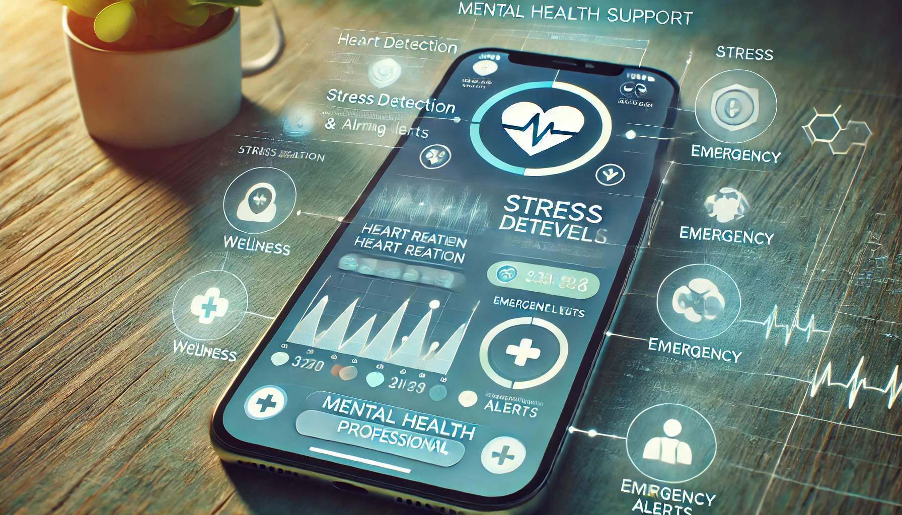
Mental Health Support
Stress Detection
Alerting
Professional Connection
System identifies signs of stress or anxiety.
Notifications sent to user and healthcare provider.
Facilitates connection with mental health experts.

Slide 11
Stress Level Calculation and Visualization
The application calculates stress levels based on a combination of heart rate and galvanic skin response (GSR). This calculation, while simplified, provides a relative indicator of stress. The stress level is then visualized on a scale of 0-100, with corresponding recommendations displayed.
1
Normal (0-25)
Relaxed and calm state.
2
Slight Elevation (26-50)
Mild stress, manageable with relaxation techniques.
3
Moderate (51-75)
Increased stress, requiring intervention and stress management strategies.
4
High (76-100)
Significant stress, potentially impacting health. Professional help may be needed.

Slide 12
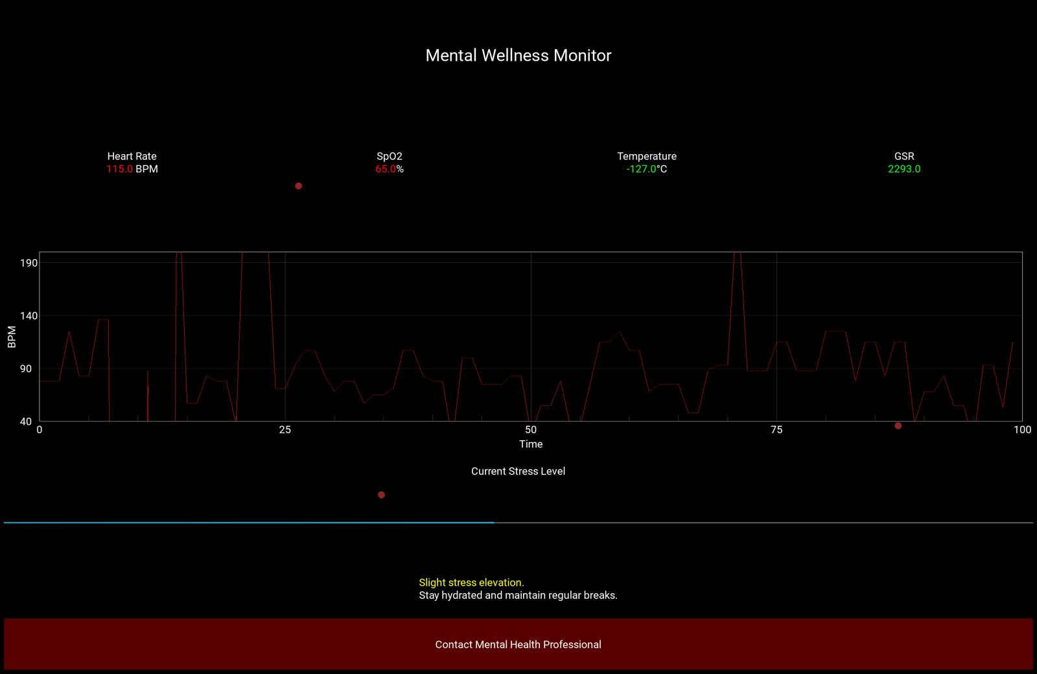
Personalized Recommendations
Based on real-time data analysis, the app offers personalized wellness recommendations. These may include breathing exercises, mindfulness practices, or suggestions for adjusting environmental factors. The recommendations are dynamically updated as the user's metrics and environment change.
Breathing Exercises
Guided breathing exercises to reduce stress and promote relaxation.
Mindfulness
Mindfulness techniques to increase awareness and manage stress.
Environmental Adjustments
Recommendations for optimizing lighting and noise levels.
Breaks
Reminders to take breaks throughout the day to prevent burnout.

Slide 13
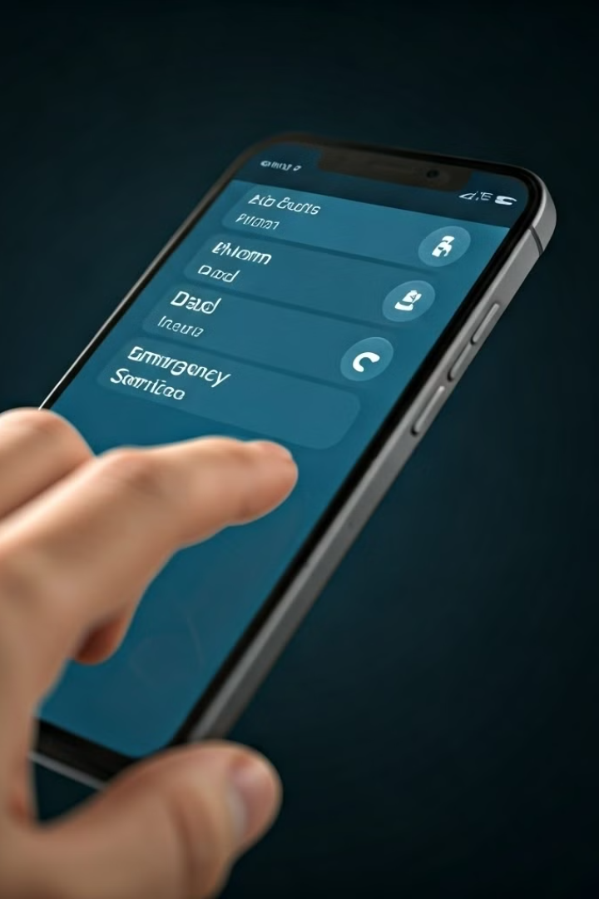

Emergency Contact Feature
The application includes an "Emergency Contact" button. When pressed, a popup window displays contact information for mental health support services, providing immediate access to assistance in critical situations.
Emergency Contact
Displays the contact number for a mental health professional or hotline.
Contact Number
Option to send a missed call to selected contacts.

